Slide 1
Figures for Transport Policy Paper
Phoenix non-disrupted SD model

Slide 2
Permanent Duration
Changing Commercial ASU FtCR

Slide 3
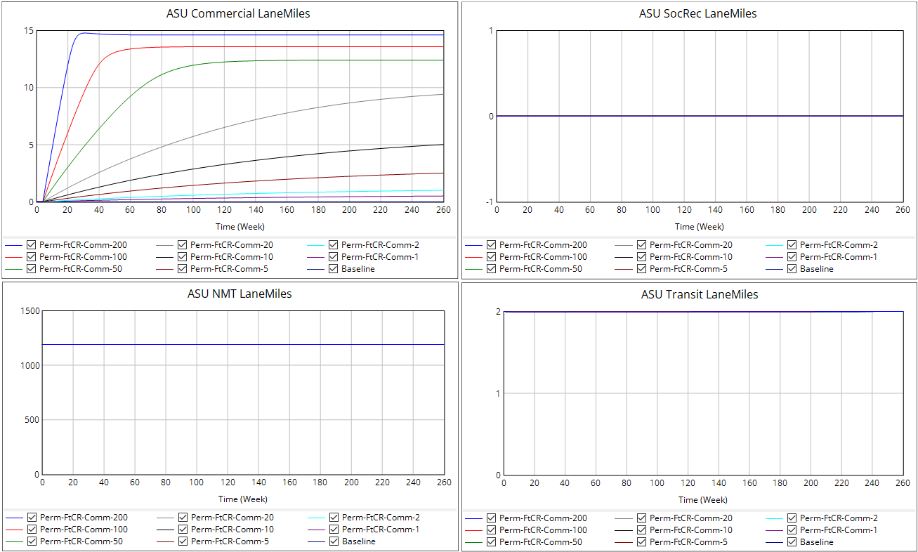
Commercial ASU FtCR effect on… ASU Lane-Miles

Slide 4
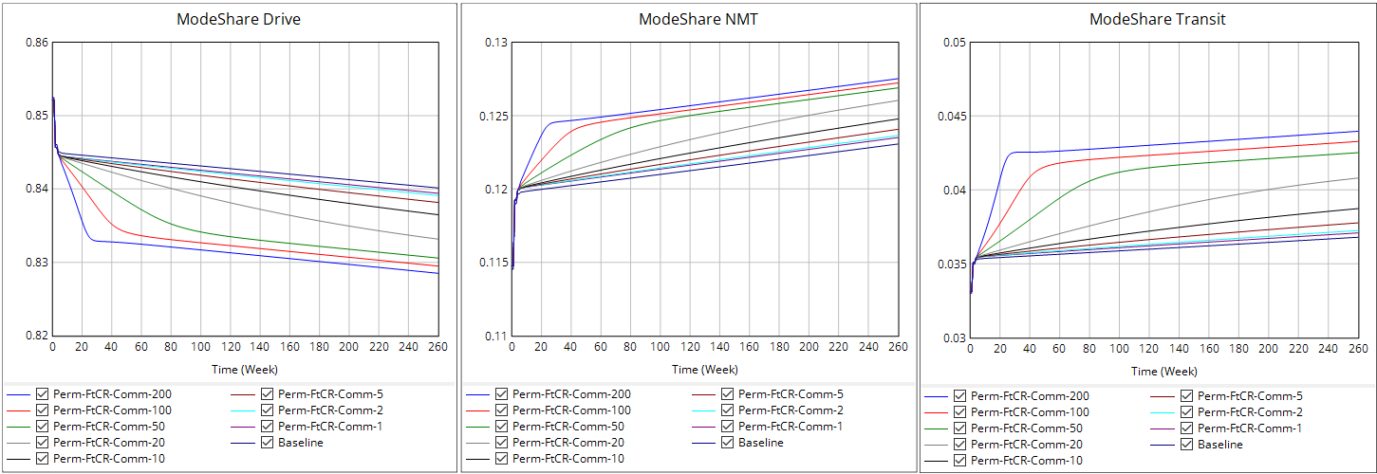
Commercial ASU FtCR effect on… Mode Share

Slide 5
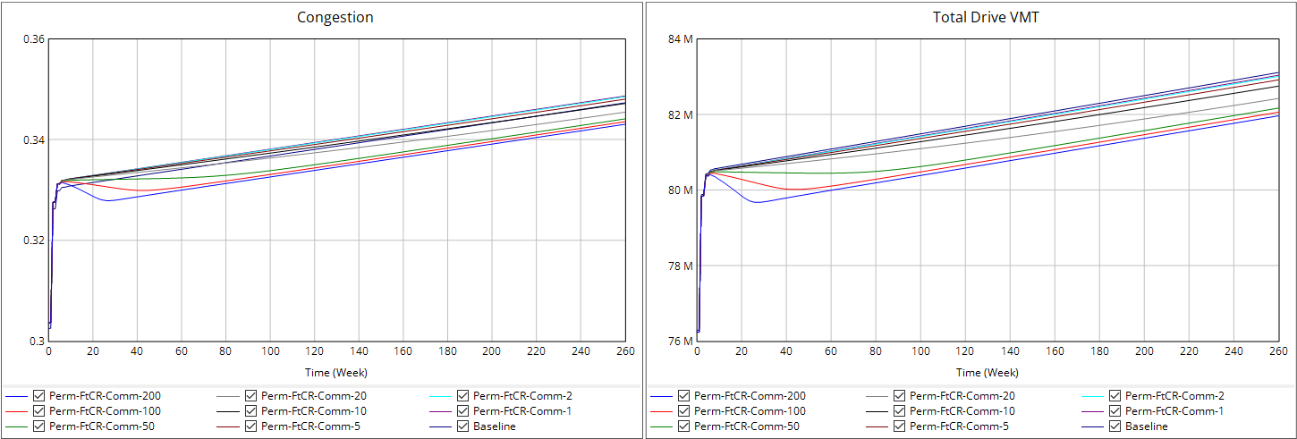
Commercial ASU FtCR effect on… Congestion and VMT

Slide 6
Permanent Duration
Changing SocRec ASU FtCR

Slide 7
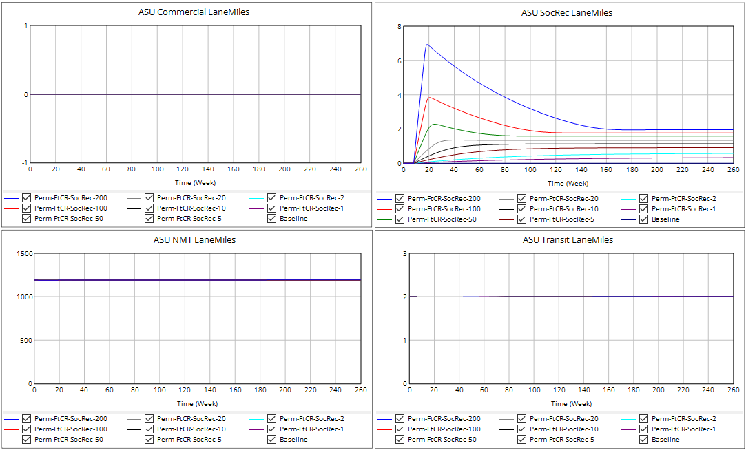
SocRec ASU FtCR effect on… ASU Lane-Miles

Slide 8
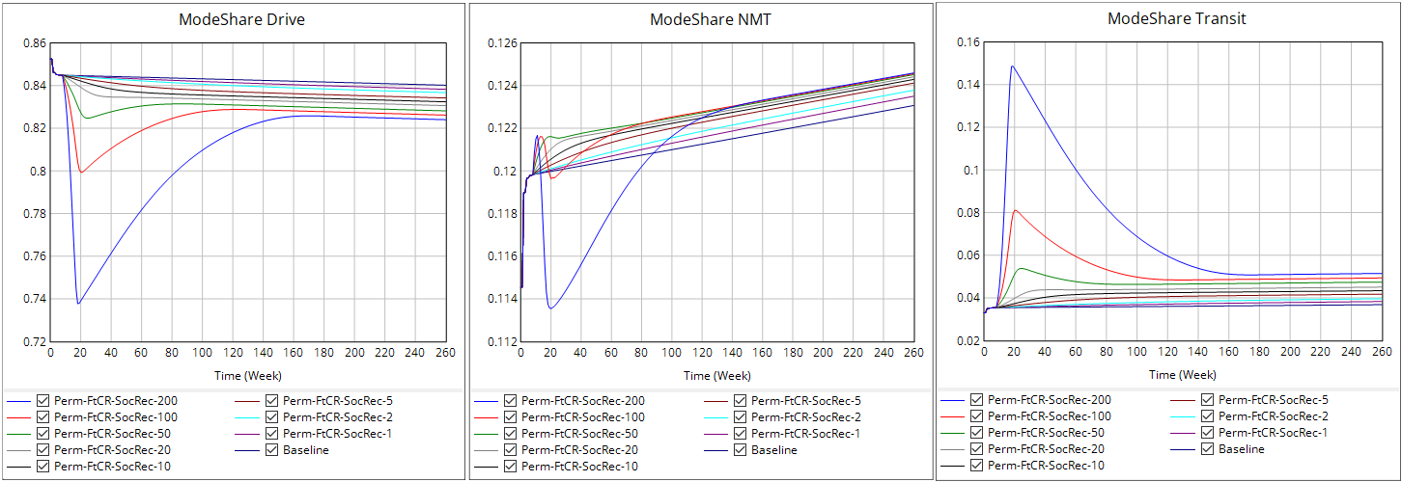
SocRec ASU FtCR effect on… Mode Share

Slide 9
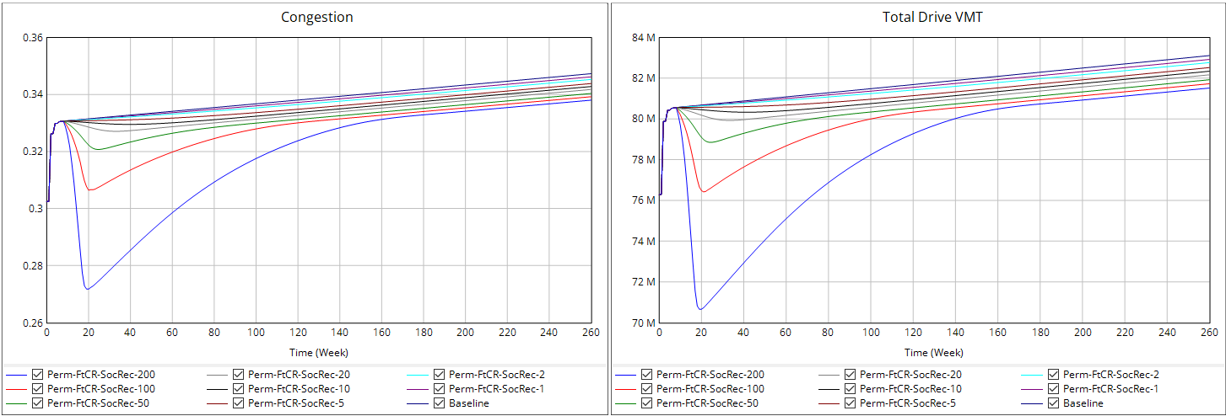
SocRec ASU FtCR effect on… Congestion and VMT

Slide 10
Permanent Duration
Changing NMT ASU FtCR

Slide 11
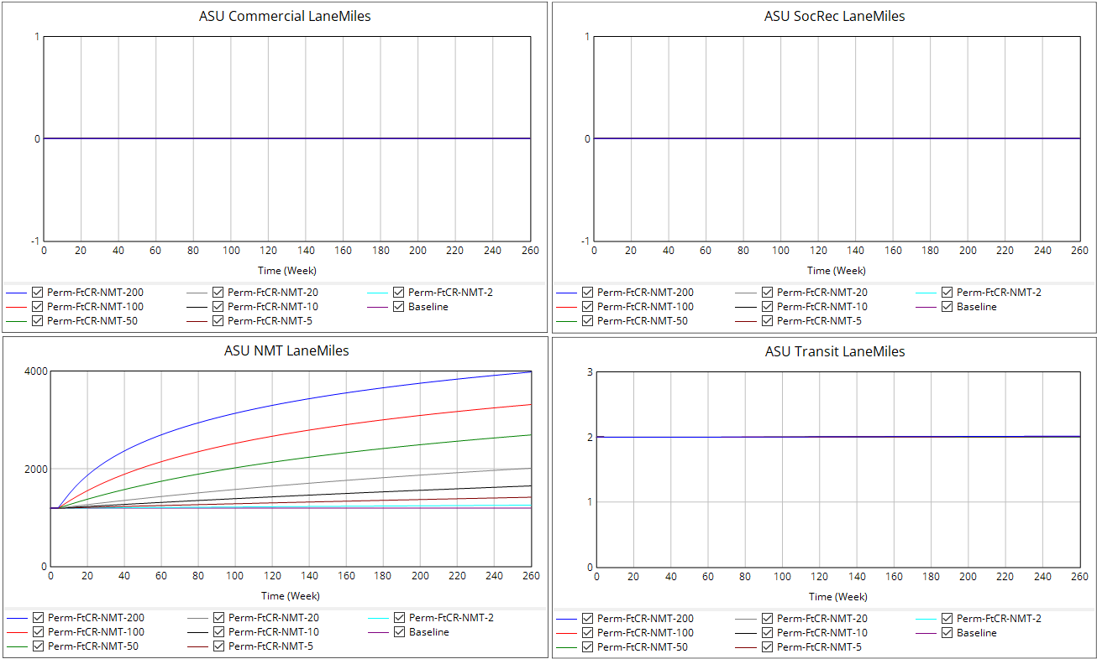
NMT ASU FtCR effect on… ASU Lane-Miles

Slide 12
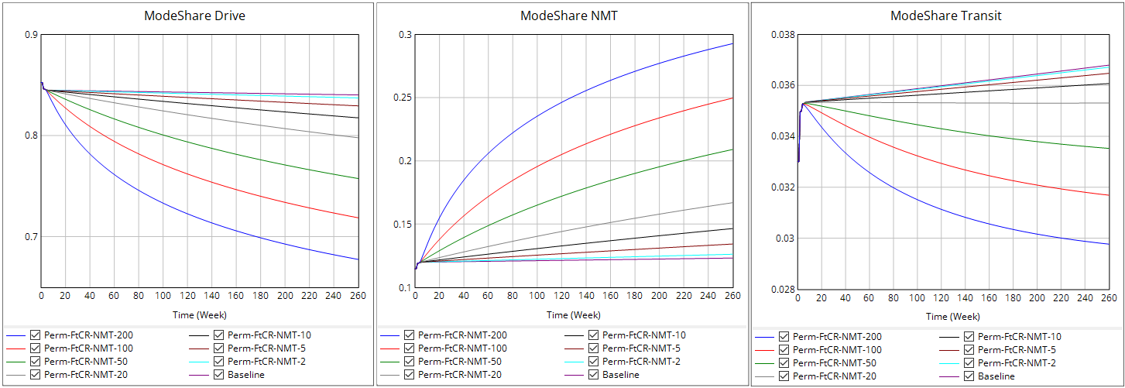
NMT ASU FtCR effect on… Mode Share

Slide 13
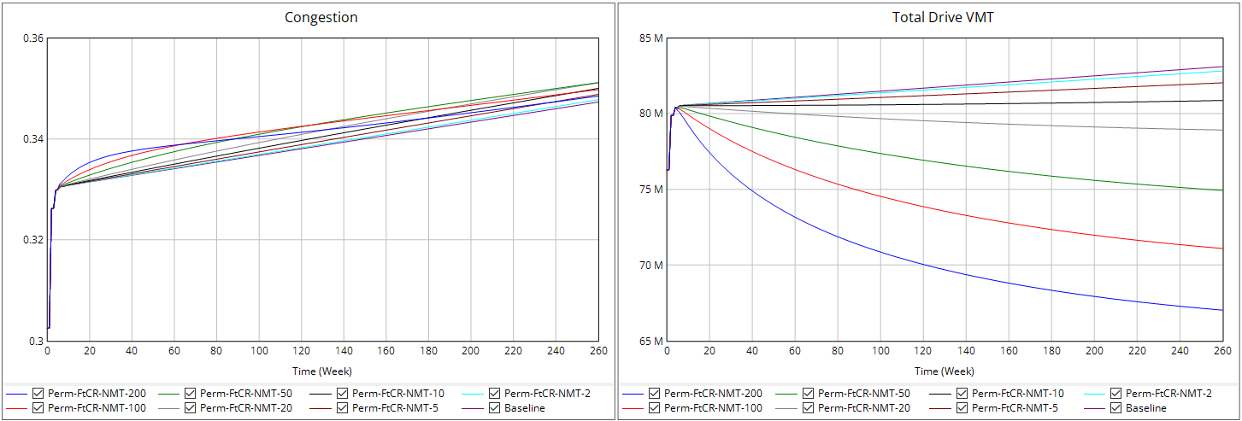
NMT ASU FtCR effect on… Congestion and VMT

Slide 14
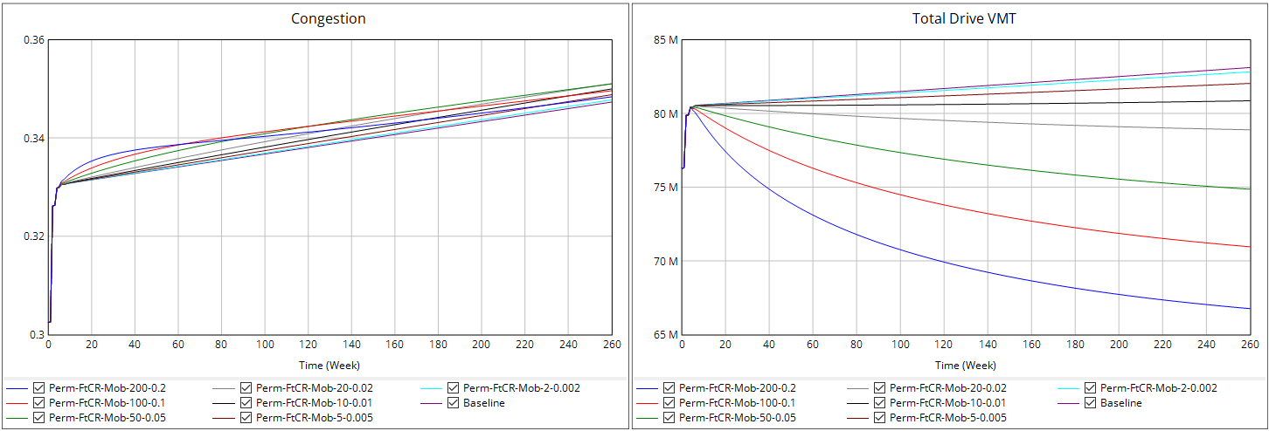
Mobility ASU FtCR effect on… Congestion and VMT

Slide 15
Permanent Duration
Changing Transit ASU FtCR

Slide 16
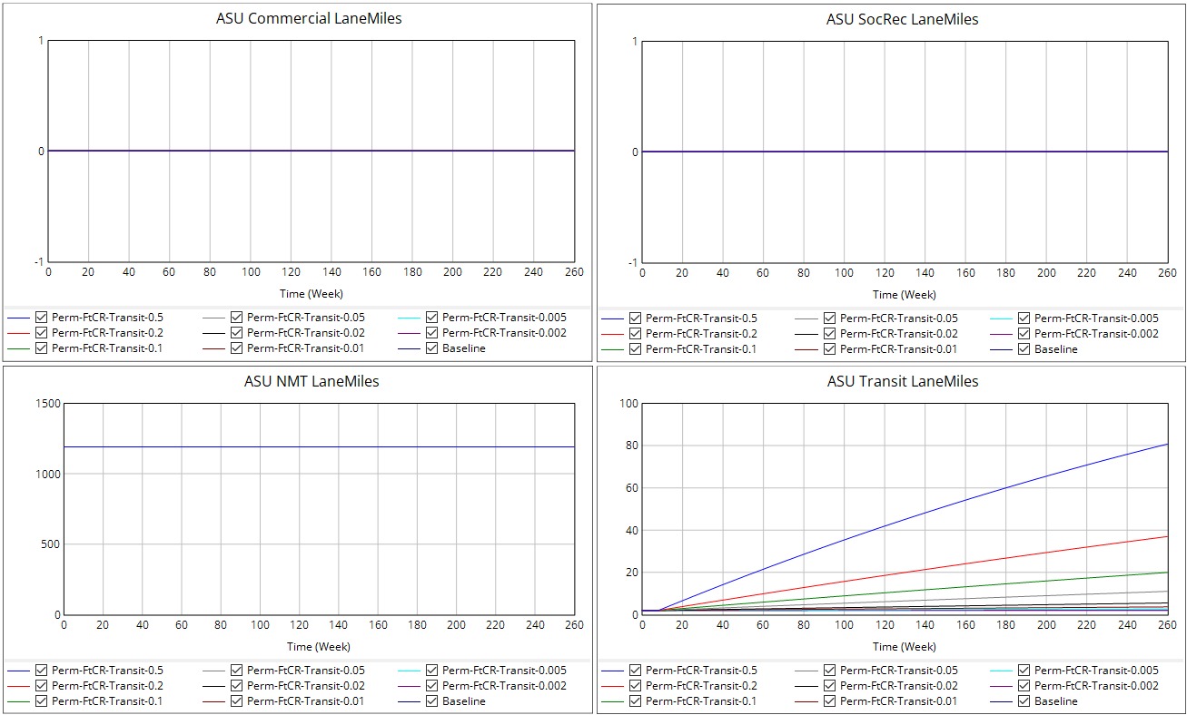
Transit ASU FtCR effect on… ASU Lane-Miles

Slide 17
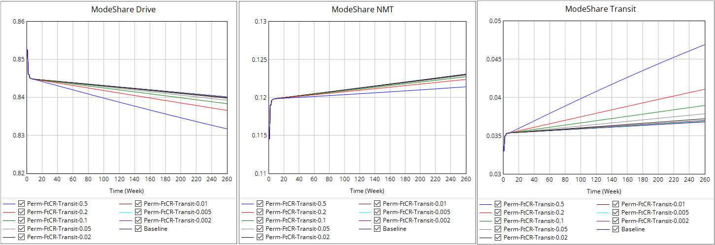
Transit ASU FtCR effect on… Mode Share

Slide 18
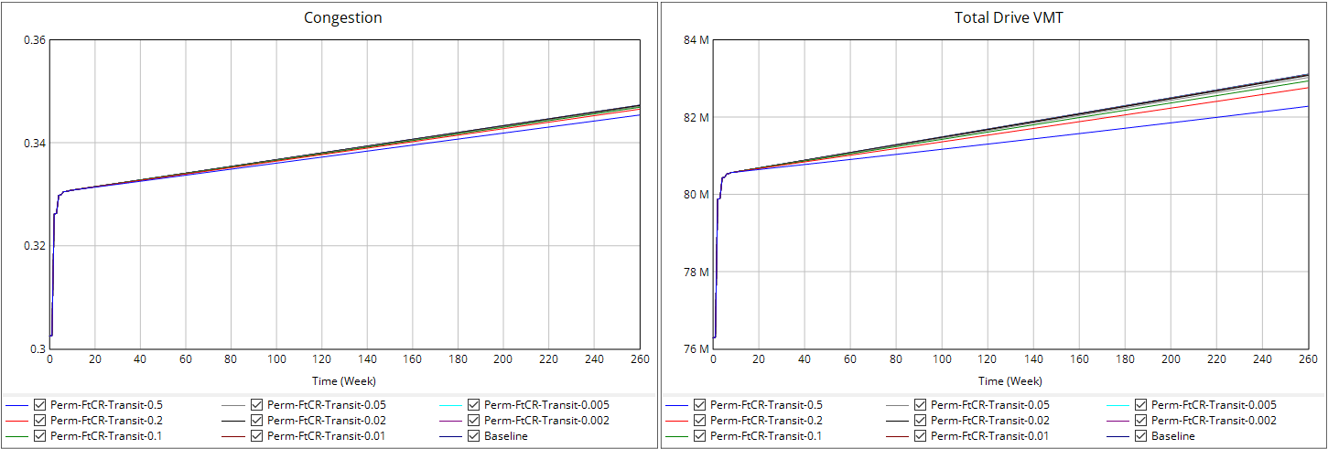
Transit ASU FtCR effect on… Congestion and VMT

Slide 19
Permanent Duration
Changing Destination ASU FtCR
(FtCR values quoted as Comm-SR)

Slide 20
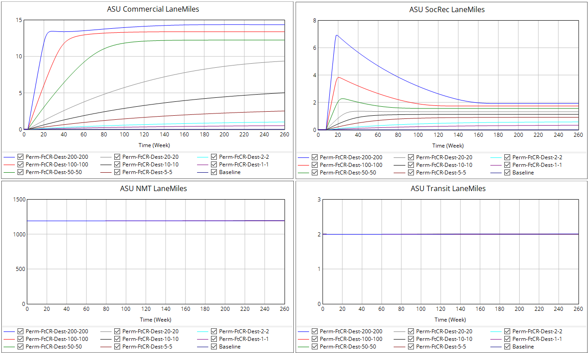
Destination ASU FtCR effect on… ASU Lane-Miles

Slide 21
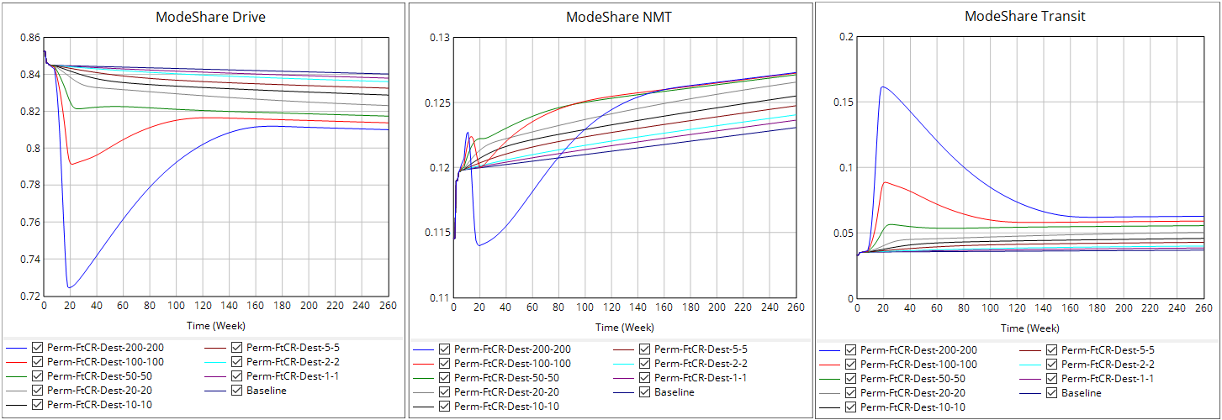
Destination ASU FtCR effect on… Mode Share

Slide 22
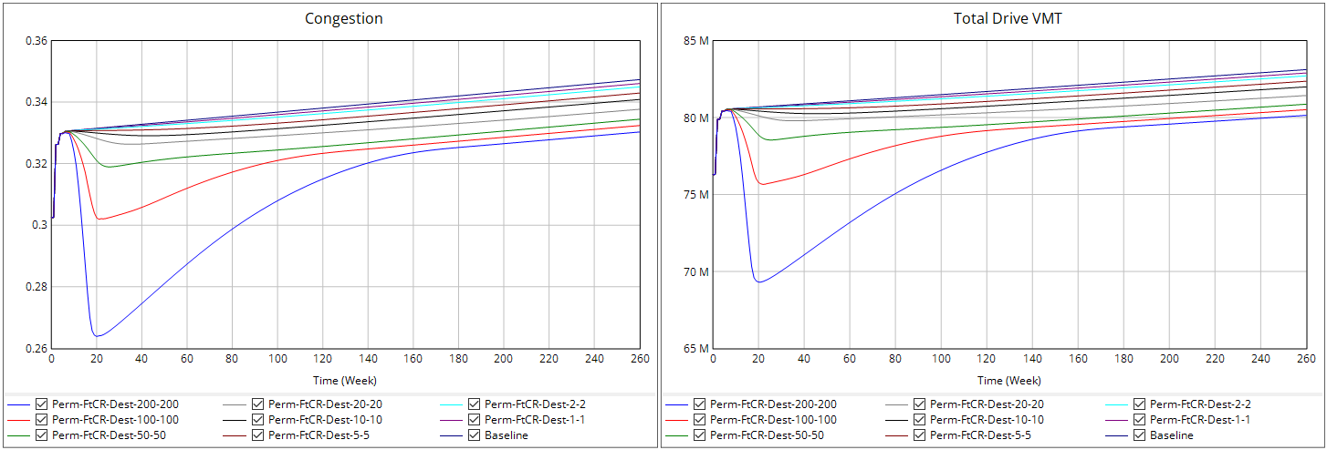
Destination ASU FtCR effect on… Congestion and VMT

Slide 23
Permanent Duration
Changing Mobility ASU FtCR
(FtCR values quoted as NMT-Transit)

Slide 24
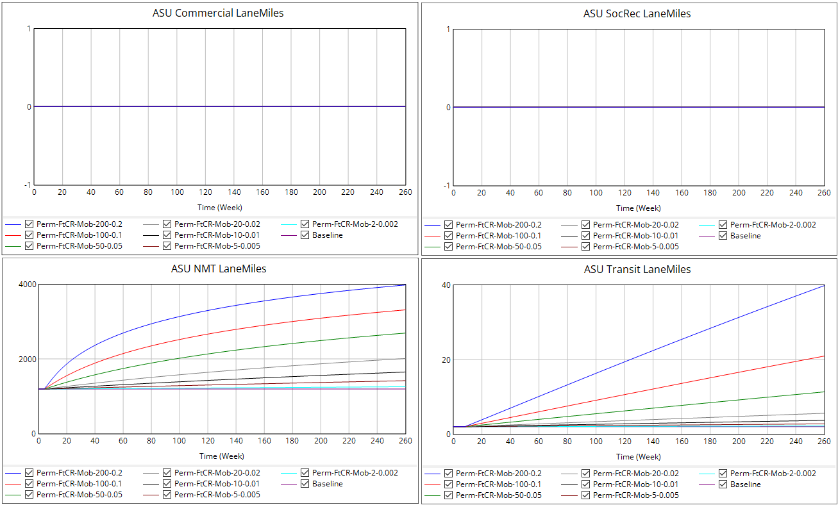
Mobility ASU FtCR effect on… ASU Lane-Miles

Slide 25
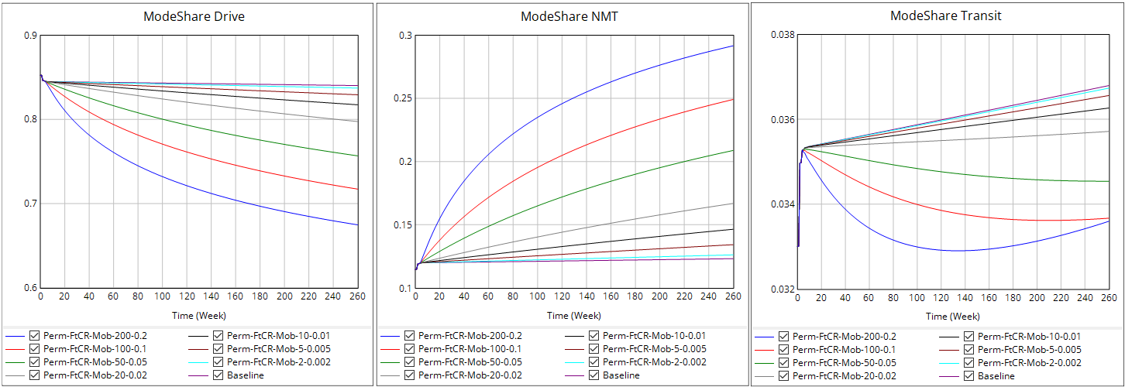
Mobility ASU FtCR effect on… Mode Share

Slide 26
Mobility ASU FtCR effect on… Congestion and VMT

